Slide 1


^{COMPUTEROME 2.0}
^{USERS WORKSHOP}
CENTER FOR HEALTH DATA SCIENCE (HEADS)
FACULTY OF HEALTH AND MEDICAL SCIENCES,
UNIVERSITY OF COPENHAGEN, FEBRUARY, 2021

Slide 2
^{PART3}
^{WORKING ON COMPUTEROME 2.}

Slide 3
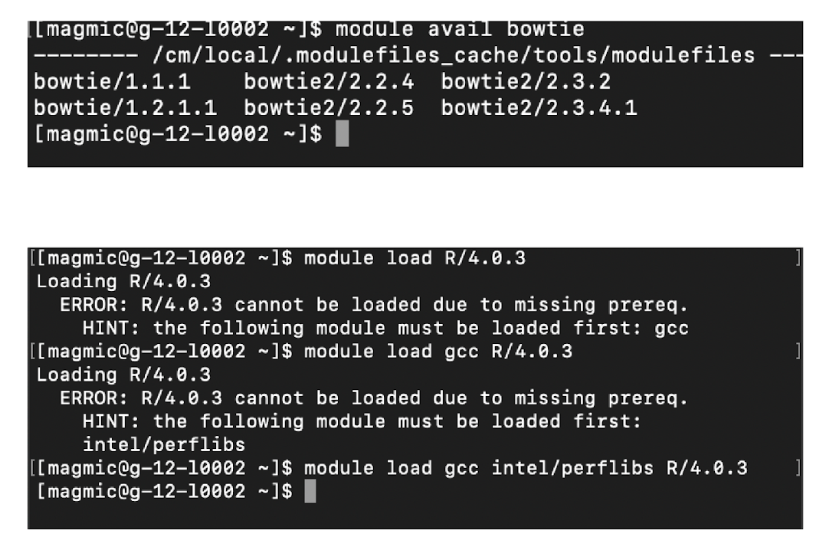
MODULES
>
LODING A MODULE: MODULE LOAD
You need to load each software you want to use (in its specific version)
module load bowtie/2.3.2
>
SEARCHING FOR A MODULE: MODULE AVAIL
First load the “tools” module: module load tools
Use the avail function with the start of your software name:
module avail bowtie
>
ADDING THE DEPENDENCIES
When there is a missing dependency, follow the suggestions.
From C2 wiki: https://www.computerome.dk/display/C2W/Installed+Software

Slide 4
REQUEST RESOURCES
>
DO NOT START ANY JOB ON THE LOGIN NODE
After you log-in, you can move around and have a look (e.g. cd, ls, cat….)
When you know what you want to do, you need to request the resources first
>
INTERACTIVE MODE WITH IQSUB
Just type iqsub in the command line
This will open a window for you to put the parameters for what you need
>
PLACE A SCRIPT IN THE QUEUE WITH QSUB
Specify the resources needed with PBS commands (e.g. in a PBS script)
Place the script in the queue with qsub
Explored in mode details this afternoon

Slide 5
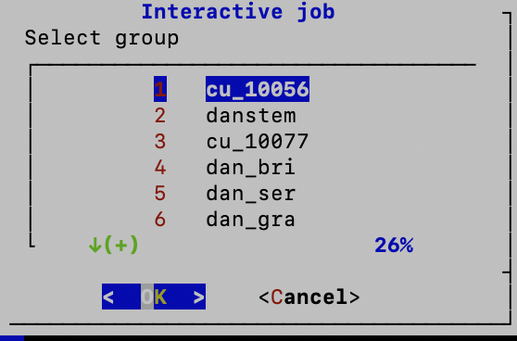
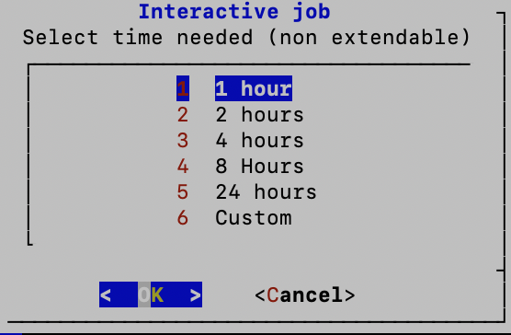
IQSUB PARAMETERS
>
PROJECT / GROUP
As part of which project / C2 group are you working
This affects who is paying
>
TIME NEEDED
This is the wall time. After this time, the resources are close.
Everything you are doing that is not saved is lost.
Better to put a bit longer than what you think you need (you can close before the end)
If you are done, you can exit with command exit ;-)

Slide 6
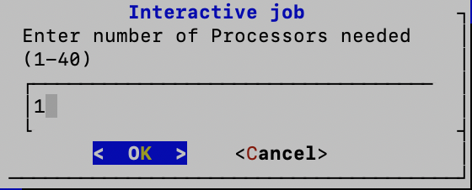
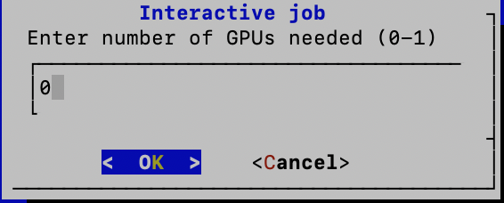
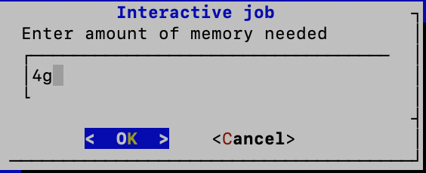
IQSUB PARAMETERS
>
NUMBER OF CPUs
Only useful for jobs that are parallelized and can benefit from several CPUs
If you don’t know, you can leave 1
>
NUMBER OF GPUs
Unless you know you need some GPU, leave it to 0
If you want to use GPU, you put 1
>
MEMORY NEEDED
Depends on the methods / software you use
E.g. mapping with STAR, you might want to increase to 60-80g

Slide 7
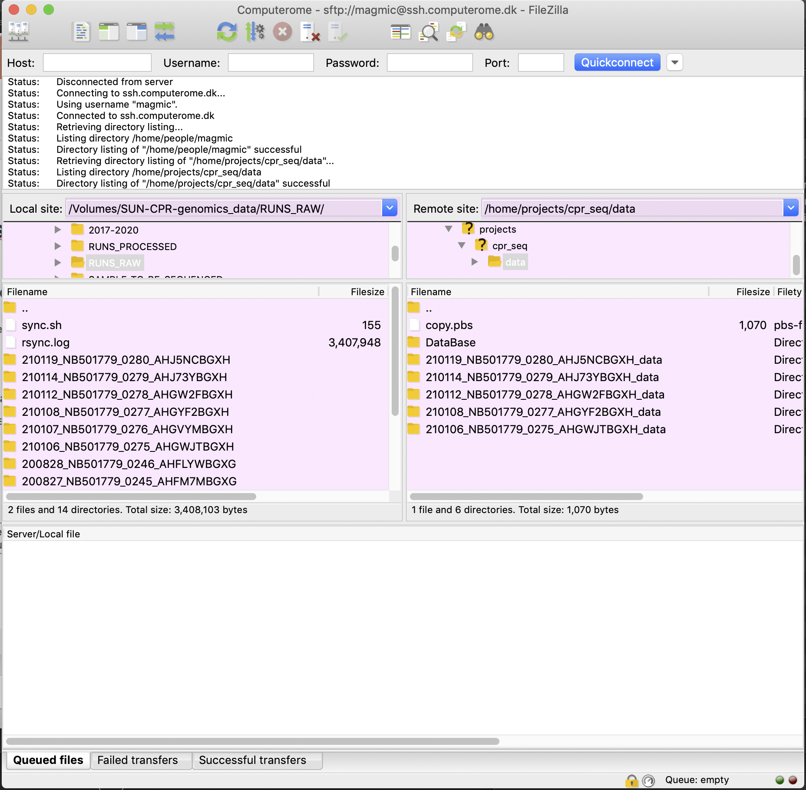
FILE TRANSFER: scp & FileZilla
>
COPY DATA FROM/TO C2 via SCP command
From local to computerome:
scp /Users/path/to/file username@ssh.computerome.dk:/home/path/to/the/destination/
From computerome to local:
scp username@ssh.computerome.dk:/home/path/to/file/ /Users/path/to/destination/
If it’s a whole folder, use -r
For more info, study the scp command (man scp)
>
>
Use FileZilla graphical interface
You can also use a software with a graphical interface
Find on the wiki how to set up the connection

Slide 8
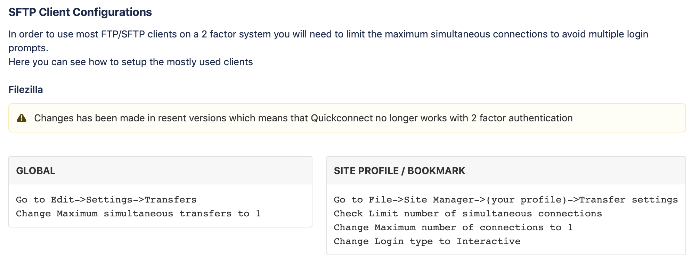
Filezilla configuration
From C2 wiki: https://www.computerome.dk/display/C2W/SSH+login+to+Computerome+2.0

